Slide 1
International Cancer Data
By: Rhoda Jiao and Maytee Chantharayukhonthorn

Slide 2
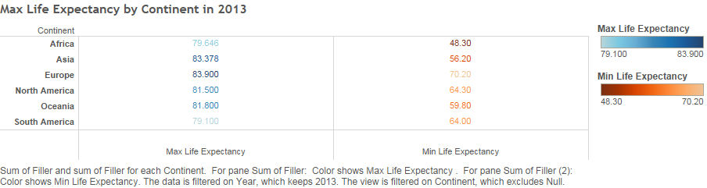
Life Expectancy by Continent (2013)

Slide 3
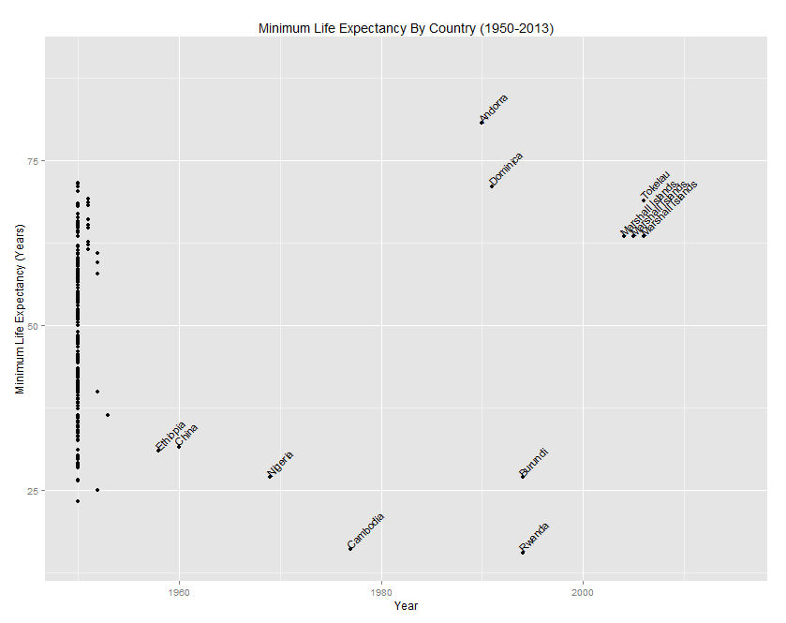

Slide 4
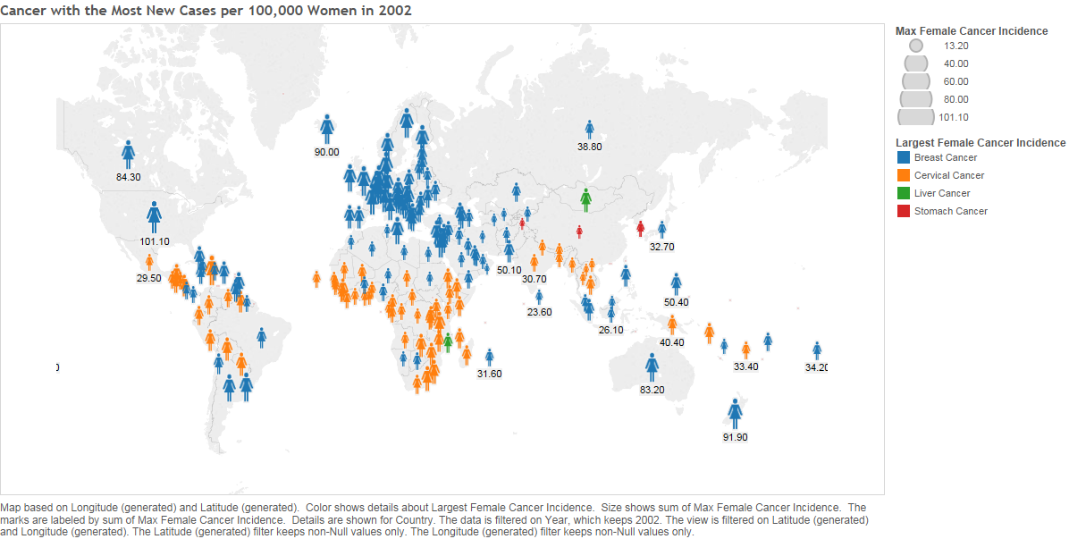

Slide 5
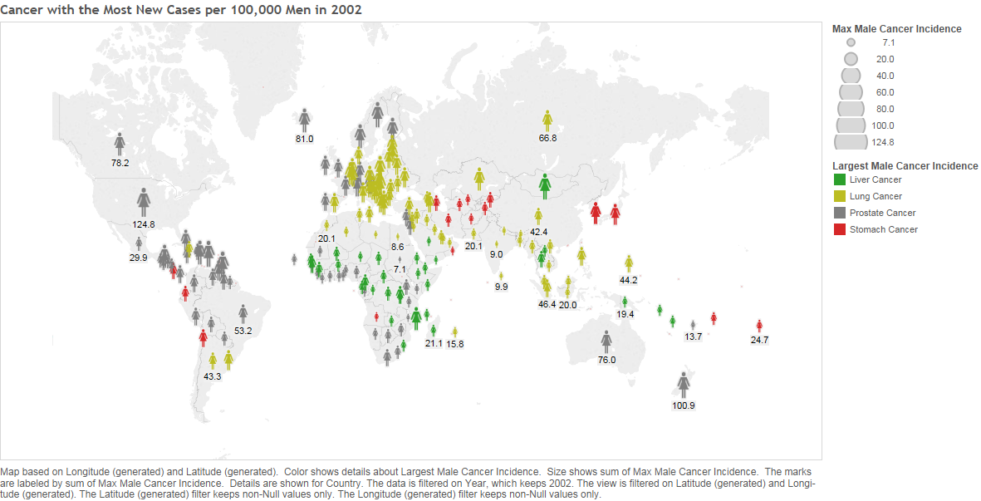

Slide 6
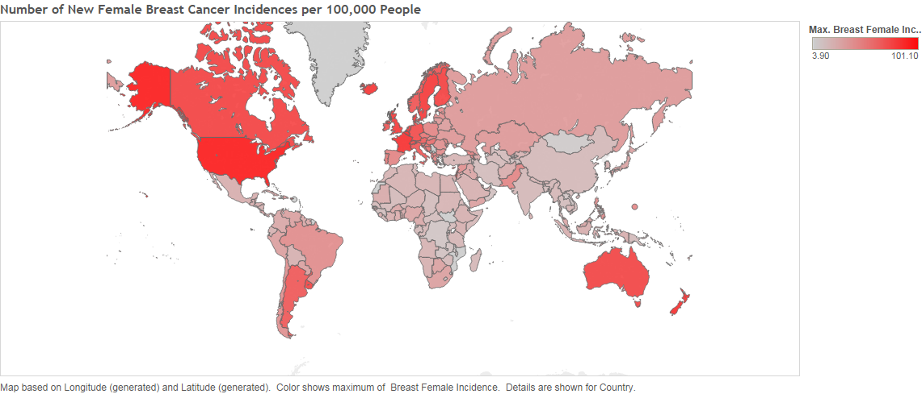

Slide 7
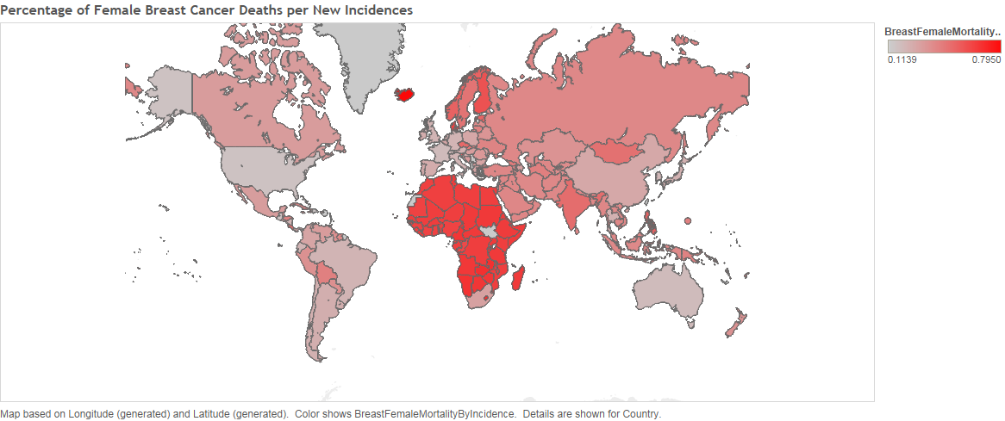

Slide 8
HDI Category Count
Continent | Low | Medium | High | VeryHigh | Total
Africa | 35 | 12 | 5 | NA | 52
Asia | 4 | 14 | 10 | 11 | 39
Europe | NA | NA | 12 | 31 | 43
North America | 1 | 4 | 14 | 3 | 22
Oceania | 2 | 4 | 3 | 2 | 11
South America | NA | 2 | 6 | 2 | 10
Total | 42 | 36 | 50 | 49 | 177

Slide 9
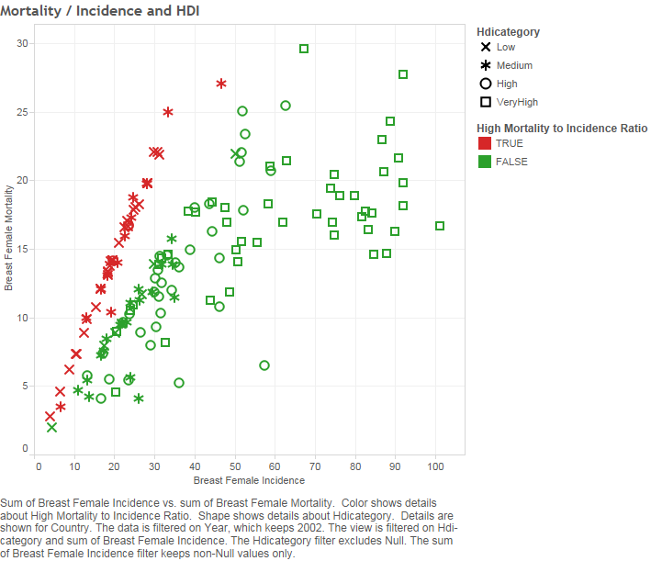

Slide 10
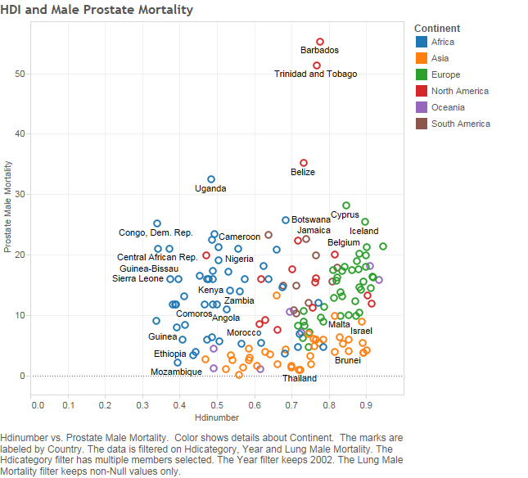

Slide 11
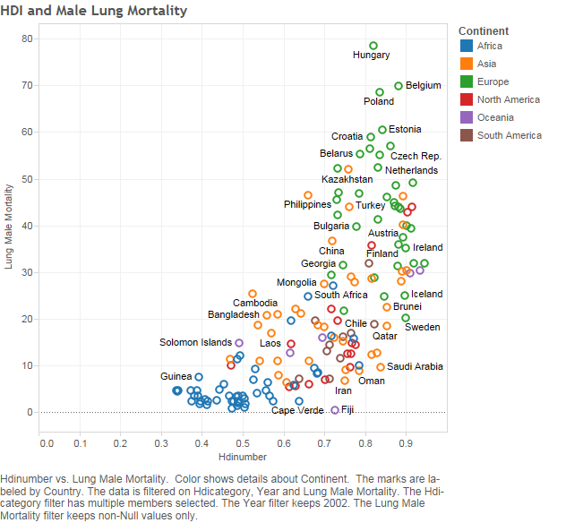

Slide 12
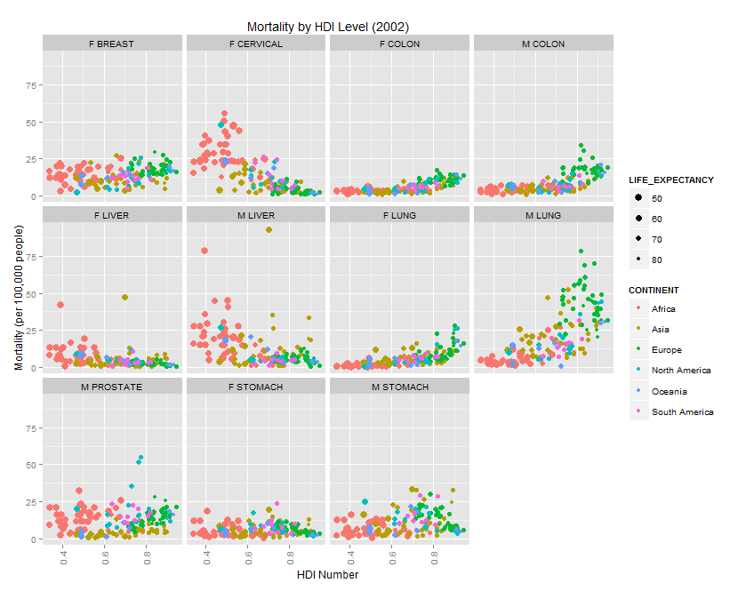

Slide 13
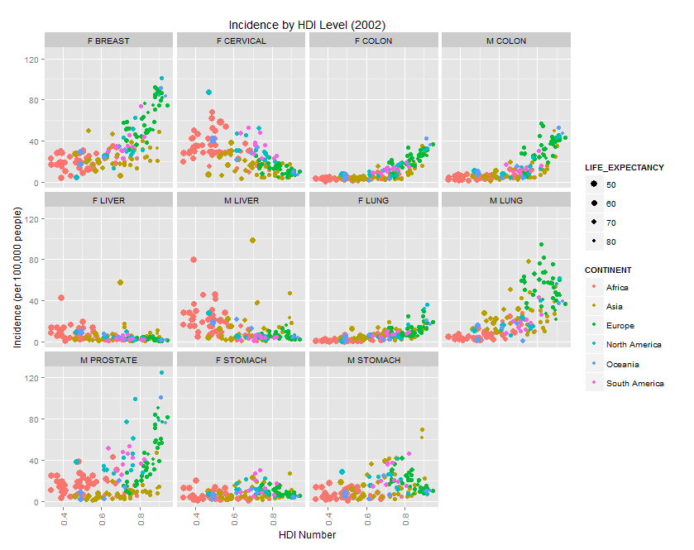

Slide 14
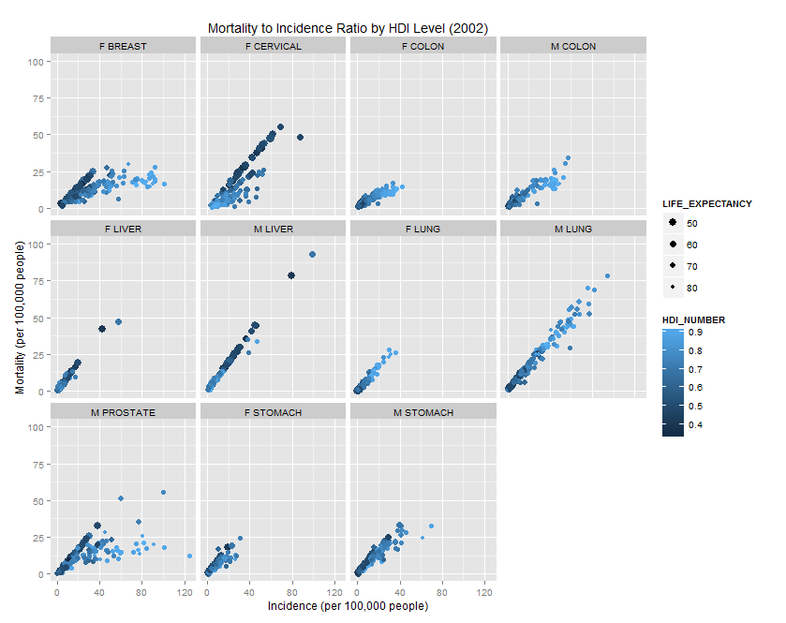

Slide 15
Male Stomach Cancer Mortality Ranked Across Continents
COUNTRY | CONTINENT | STOMACH_M_MORTALITY | MORTALITY_MIN | MORTALITY_DIFF | MORTALITY_RANK
Congo, Dem. Rep. | Africa | 17.9 | 0.5 | 17.4 | 1
Mali | Africa | 16.1 | 0.5 | 15.6 | 2
Angola | Africa | 13.3 | 0.5 | 12.8 | 3
…………. | …………… | …………. | ……. | …… | ………
Korea, Dem. Rep. | Asia | 37.1 | 1.4 | 35.7 | 1
Mongolia | Asia | 33.4 | 1.4 | 32 | 2
Korea, Rep. | Asia | 32.72 | 1.4 | 31.32 | 3
…………. | …………… | …………. | ……. | …… | ………
Belarus | Europe | 29.67 | 5.11 | 24.56 | 1
Ukraine | Europe | 22.48 | 5.11 | 17.37 | 2
Azerbaijan | Europe | 21.97 | 5.11 | 16.86 | 3
…………. | …………… | …………. | ……. | …… | ………
Haiti | N. America | 25.1 | 3.38 | 21.72 | 1
Costa Rica | N. America | 21.36 | 3.38 | 17.98 | 2
Jamaica | N. America | 20 | 3.38 | 16.62 | 3
…………. | …………… | …………. | ……. | …… | ………
Samoa | Oceania | 21.4 | 2 | 19.4 | 1
French Polynesia | Oceania | 21.4 | 2 | 19.4 | 1
Solomon Islands | Oceania | 7.8 | 2 | 5.8 | 3
……………... | …………… | ……….. | … | ……… | …………
Peru | S. America | 29.5 | 9.15 | 20.35 | 1
Chile | S. America | 28.34 | 9.15 | 19.19 | 2
Colombia | S. America | 17.665 | 9.15 | 8.515 | 3

Slide 16
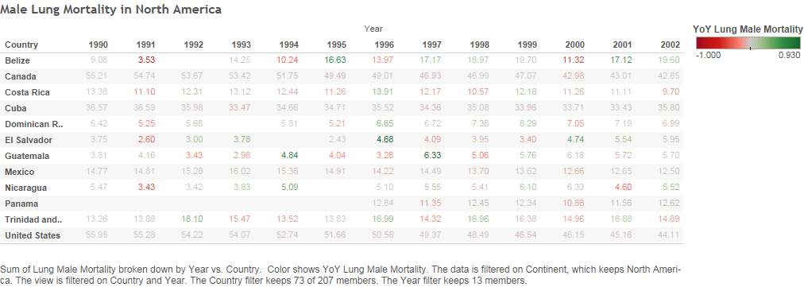

Slide 17
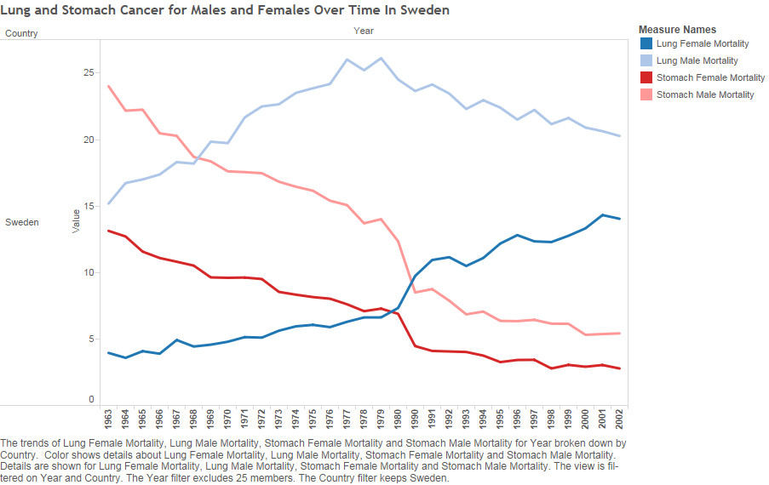

Slide 18
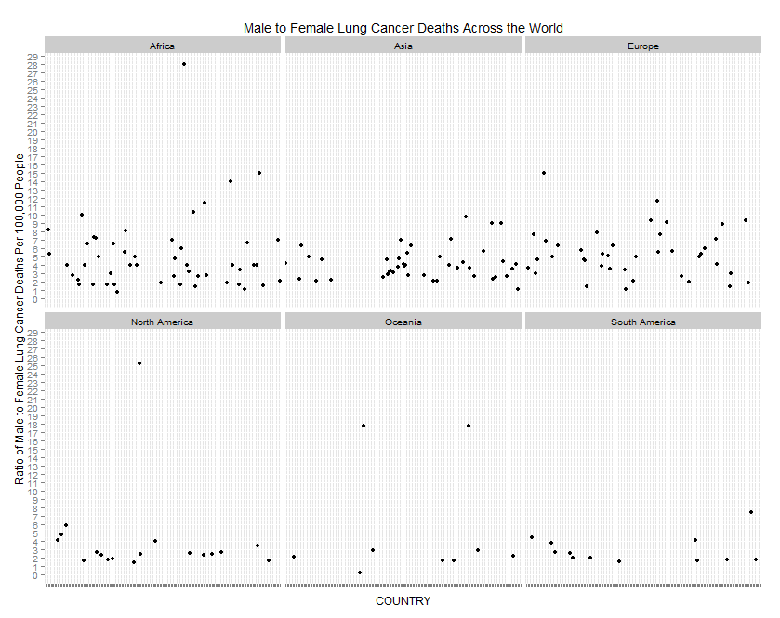

Slide 19
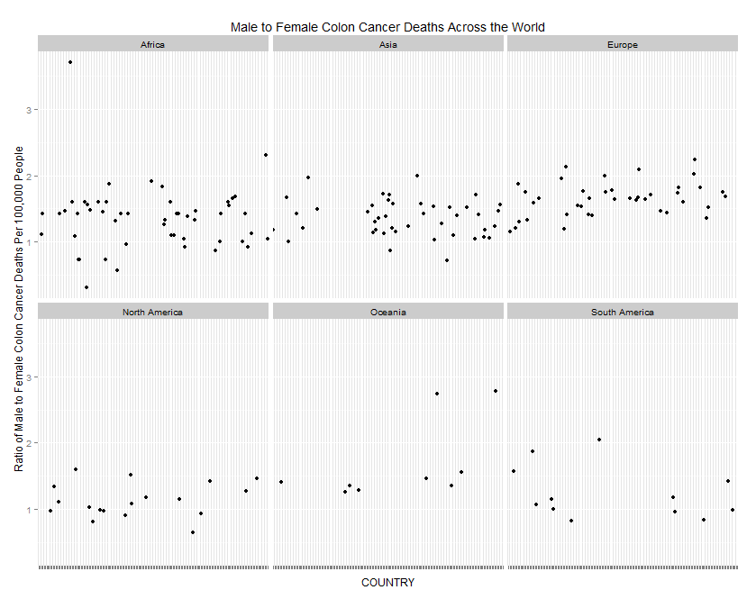

Slide 20
